Slide 1
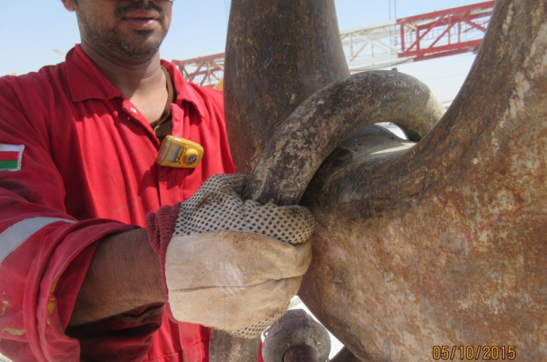
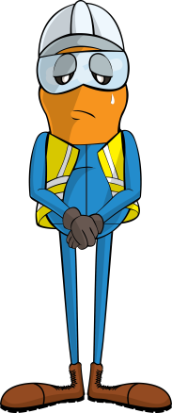
PDO Incident First Alert
Incident type | LTI (#40) | PIM ID | 1091103
Date/ time | 04/10/2015 (14:30 hrs) | Directorate
Location | Marmul | Dept
What happened
A roustabout was placing a sling on to a crane hook. As he dropped the sling down on to the hook he forgot that his fingers were still holding the sling and two of them were crushed between the hook and sling painfully fracturing them.
Mr. Musleh asks the questions of can it happen to you?
Do you always know where you are placing your fingers?
Do you always think where your fingers might become trapped?
Are you always giving your task your full attention?
Please disseminate this LTI notification to your teams and use it in your tool box talks and HSE meetings and notice boards.

