Slide 1
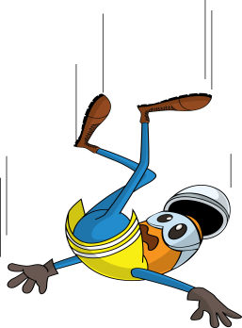
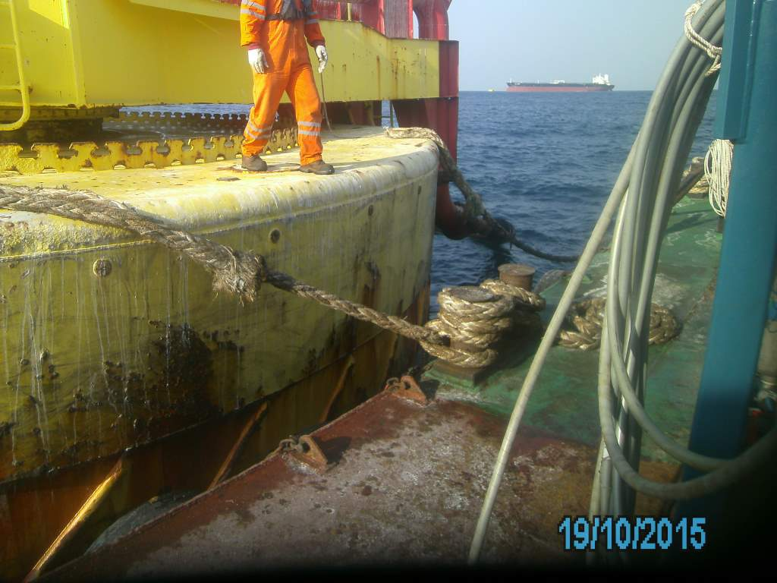
PDO Incident First Alert
Incident type | LTI (#41) | PIM ID | 1091275
Date/ time | 19/10/2015 (10:15 hrs) | Directorate
Location | Mina Al Fahal | Dept
What happened
A maintenance worker had completed washing down a buoy and attempted to cross a gap from the buoy to a barge. As he jumped onto the barge he landed badly twisting his left knee.
0.5m
Mr. Musleh asks the questions of can it happen to you?
0.5m
Do you always ensure a walkway is in place?
Are you always giving your task your full attention?
Do you ever jump the gap rather than using the safe access?
Please disseminate this LTI notification to your teams and use it in your tool box talks and HSE meetings and notice boards.

