Slide 1
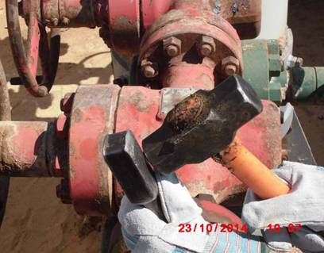
PDO Incident First Alert
Incident type | LTI (#42) | PIM ID | 1091304
Date/ time | 22/10/2015 (11:15 hrs) | Directorate
Location | Harweel area | Dept
What happened
A technician was hitting an impact spanner to try and loosen a nut. He lost his balance and the hammer hit his thumb instead, fracturing it in the process
Mr. Musleh asks the questions of can it happen to you?
Do you always keep a good balance ?
Do you always pay attention?
Do you keep your fingers away from where you are hammering?
Impact spanner
Thumb being hit
Please disseminate this LTI notification to your teams and use it in your tool box talks and HSE meetings and notice boards.

