Slide 1
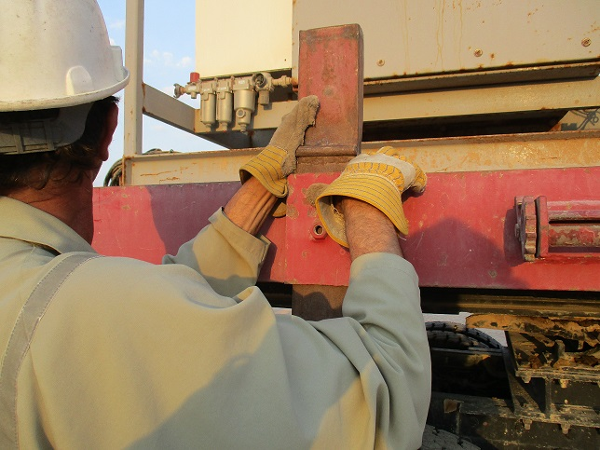
PDO Incident First Alert
Incident type | LTI (#44) | PIM ID | 1091438
Date/ time | 02/11/2015 (16:30 hrs) | Directorate
Location | Barik | Dept
Stanchion
What happened
While installing a stanchion (side support post) on a vehicle trailer, a helper inserted the stanchion upside down causing the post to slide much further down than anticipated resulting in the stopper trapping two fingers which resulted in a fracture to his index finger.
Mr. Musleh asks the questions of can it happen to you?
Do you ensure the equipment is in the correct position?
Do you always pay attention?
Do you keep your fingers out of the line of fire?
Stopper
Please disseminate this LTI notification to your teams and use it in your tool box talks and HSE meetings and notice boards.

