Slide 1
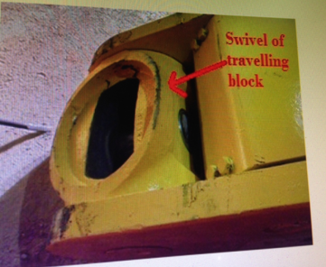
PDO Incident First Alert
Incident type | LTI (#45) | PIM ID | 1091528
Date/ time | 11/11/2015 (19:30 hrs) | Directorate
Location | Lekhwair | Dept
What happened
A crane was rigging a new traveling block up to the rig floor. The driller thinking the travelling block swivel was stuck tried to free it by hand and as it came free it rotated trapping his thumb against the body of traveling block . He lost the tip of his thumb.
Mr. Musleh asks the questions of can it happen to you?
What will happen when you free something that is stuck?
Do you keep your fingers out of the line of fire?
Do you check its safe before you place your hands near moving parts?
Trap point
Please disseminate this LTI notification to your teams and use it in your tool box talks and HSE meetings and notice boards.

