Slide 1
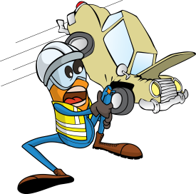
PDO Incident First Alert
Incident type | MVI Rollover LTI (#46) | PIM ID | 1091527
Date/ time | 10/11/2015 (16:30 hrs) | Directorate
Location | Al Auwafiya | Dept
What happened
A Drilling Superintendent lost control of his vehicle while taking a curve in the road, the vehicle has rolled over onto its right side, as a result he sustained injuries to his left hand and fingers.
Mr. Musleh asks the questions of can it happen to you?
Do you inspect your vehicle before you start your journey?
Do you check your tyres are in good condition?
Do you always wear your seatbelt ?
Do you continue driving if you are fatigued?
Please disseminate this LTI notification to your teams and use it in your tool box talks and HSE meetings and notice boards.

