Slide 1

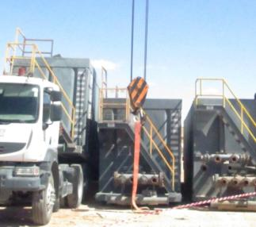


PDO Incident First Alert
Incident type | Fatality crush Injury LTI (#47) | PIM ID | 1091574
Date/ time | 17/11/2015 (11:40 hrs) | Directorate
Location | Nimr | Dept
What happened
The deceased stood between two Frac tanks and reached under one of the tanks to pull on the locking handle of a pin connection between truck and tank (5th wheel). A crane was in place to hold the tanks weight after the truck had driven out from under the tank. The crane boom was positioned slightly wrong and as the crane took the weight, the tank swung sideways crushing the deceased between the two tanks. He died shortly afterwards.
Mr. Musleh asks the questions of can it happen to you?
Are you using defective equipment instead of getting it repaired?
Is there always a competent supervisor managing lifting operations?
Do you consider crush points in your lifting plan?
Do you consider if you are ever in the ‘line of fire’?
Position of deceased
Please disseminate this LTI notification to your teams and use it in your tool box talks and HSE meetings and notice boards.

