Slide 1
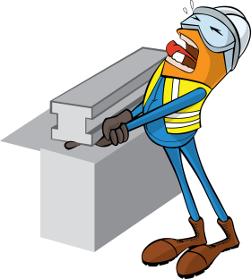
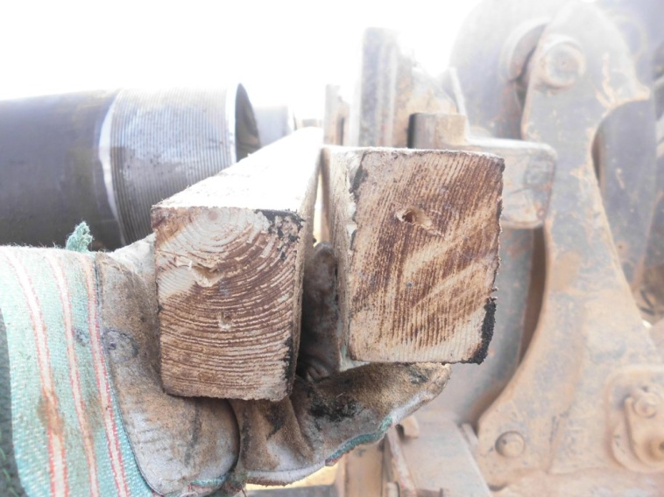
PDO Incident First Alert
Incident type | LTI (#48) | PIM ID | 1091733
Date/ time | 08/12/2015 (14:00 hrs) | Directorate
Location | Lekhwair | Dept
Pinch point
What happened
A roustabout saw that casing pipes were overhanging the end of a pipe rack. He called the forklift truck to help push them back in line. To protect the casings he held two pieces of wood between the forks and casings but left his finger in between them. As the forks pushed against the wood his finger was crushed and the tip amputated.
Mr. Musleh asks the questions of can it happen to you?
Do you always use the correct equipment?
Do you ever take short cuts?
Do you consider pinch points?
Do you ensure you are out of the ‘line of fire’?
Please disseminate this LTI notification to your teams and use it in your tool box talks and HSE meetings and notice boards.

