Slide 1
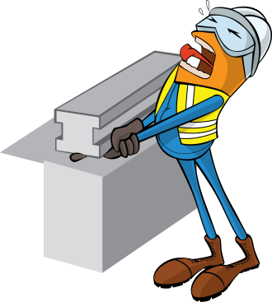
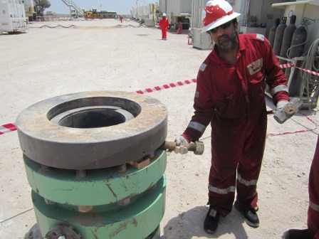
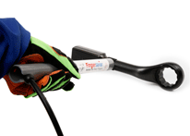
PDO Safety Advice
Use this Advice: Discuss in Tool Box Talks and HSE Meetings ➔ Distribute to contractors ➔ Post on HSE Notice Boards
Date: 09.08.2015
LTI: Crushed finger
What happened?
An assistant driller tried to release some jammed slips from inside the lock wellhead by hammering a bolt between the wellhead flange. As the slips released they dropped causing the flange to drop onto the bolt trapping his right hand index finger between the bolt and flange.
Your learning from this incident..
Use hands off technique whenever possible.
Ensure all hazards and risks are identified before starting work.
Ensure learning from previous incidents are communicated.
Supervisors to supervise tasks and not perform them.
Always think to use hands off technique.
Contact MSE34 for further information Learning No 39 09/08/2015

Slide 2
Management learning's
Distribute to contractors ➔ Post on HSE Notice Boards
Date: 09.08.2015
LTI: Crushed finger
As a learning from this incident and to ensure continual improvement all
contract managers are to review their HSE HEMP against the questions
asked below:
Confirm the following:
Do you have procedures for installation and decommissioning of 3rd party equipment?
Does your drilling crews use impact gloves when required?
Do you ensure hands off equipment is available and used on site?
Are your crews trained and encouraged to use hands off techniques?
Contact MSE34 for further information Learning No 39 09/08/2015

