Slide 1
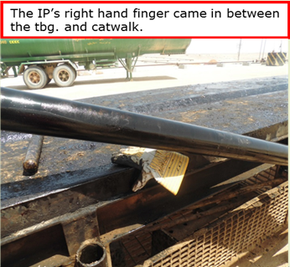
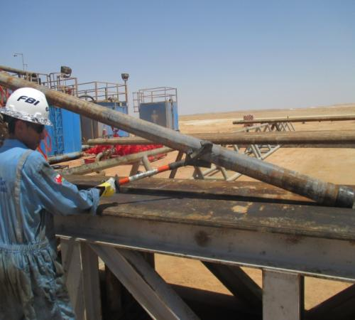
PDO Safety Advice
Use this Advice: Discuss in Tool Box Talks and HSE Meetings ➔ Distribute to contractors ➔ Post on HSE Notice Boards
Date:15.08.2015
LTI: Fractured finger
What happened?
During pulling out of hole, the crew were laying down the tubing joints on the catwalk using cat line when the joint became stuck. The roustabout was standing next to the catwalk with his right hand resting on its edge and as a tubing joint came down the ramp, it jumped out of the V groove and struck his hand fracturing a finger.
Your learning from this incident..
Ensure hazards are identified and discussed with the work force
Ensure correct equipment is available and utilised
Always ensure workers are following correct practices
Always ensure you hands and fingers are clear of pinch points
Stay out of the “Line of Fire”
Stay out of the “Line of Fire”
Contact MSE34 for further information Learning No 40 15/08/2015

Slide 2
Management learning's
Distribute to contractors ➔ Post on HSE Notice Boards
Date:15.08.2015
LTI: Fractured finger.
As a learning from this incident and to ensure continual improvement all
contract managers are to review their HSE HEMP against the questions
asked below:
Confirm the following:
Does your standards/procedures address the handling of tubing, lay down and pick up from Catwalk and use of safety tool?
Is the equipment available and utilised?
Is there a clear method of communication?
Does your HEMP address hazards and ergonomics?
Contact MSE34 for further information Learning No 40 15/08/2015

