Slide 1
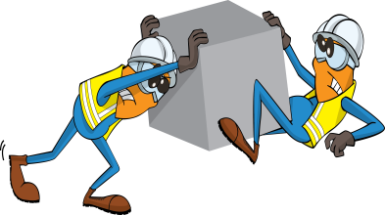
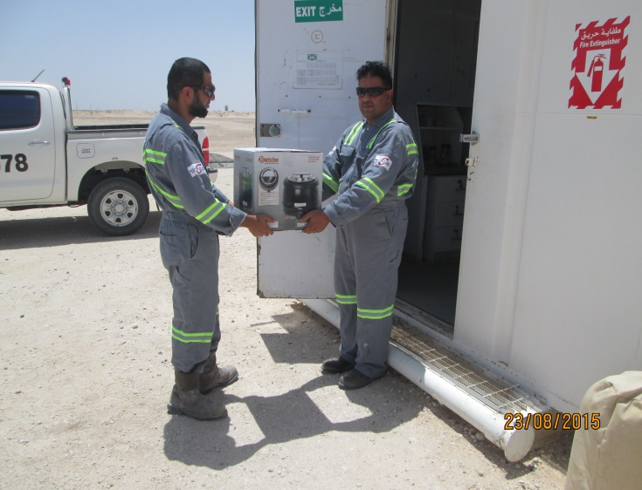
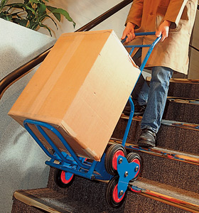
PDO Safety Advice
Use this Advice: Discuss in Tool Box Talks and HSE Meetings ➔ Distribute to contractors ➔ Post on HSE Notice Boards
Manual Handling Heavy Equipment
Date: 19.08.2015
LTI: fractured fingers.
What happened?
An electrician with the assistance of a radio operator was moving a metal safe from the rear of a “pick up” to the radio room, walking backwards. On reaching the door, he tripped on the step falling backwards. The metal safe landed on top of his left hand crushing his middle and ring finger resulting in a fracture.
Your learning from this incident..
Routine manual handling tasks must be planned and dynamically assessed.
Manual handling tasks, hazards and risks should be subject to regular refresher through tool box talks.
The correct equipment should be made available for handling heavy items.
55Kg
Corrective Action – Use Manual Handling Aids
Assess the weight, use handling aids if needed
Contact MSE34 for further information Learning No 41 19/08/2015

Slide 2
Management learning's
Distribute to contractors ➔ Post on HSE Notice Boards
Date: 19.08.2015
LTI: fractured fingers.
As a learning from this incident and to ensure continual improvement all
contract managers are to review their HSE HEMP against the questions
asked below:
Confirm the following:
Are all manual handling tasks planned and risk assessed?
Do you have the sufficient handling aids available?
Do you conduct manual handling related tool box talks and regular refreshers in correct handling techniques?
Contact MSE34 for further information Learning No 41 19/08/2015

