Slide 1
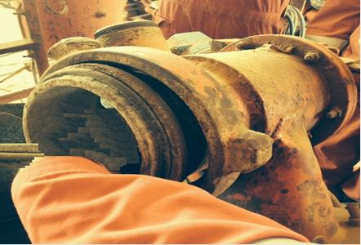
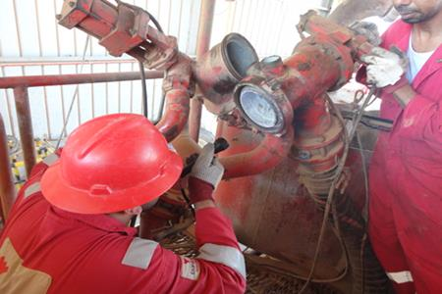
PDO Safety Advice
Use this Advice: Discuss in Tool Box Talks and HSE Meetings ➔ Distribute to contractors ➔ Post on HSE Notice Boards
Date: 28/08/2015
LTI: Fractured Fingers
What Happened?
A Supervisor inserted his hand into the cement head of the mixing
system unit to check for cement blockage. He then instructed the
operator at the control panel to open the hydraulic valve while leaving
his hand in the line of fire. His left hand middle and ring fingers were
caught by the hydraulic valve resulting in a fracture.
Your learning from this incident..
Only competent mechanics should conduct maintenance tasks.
Don’t take short-cuts.
Intervene and Stop Unsafe Acts.
Ensure good communication between operators.
All incidents must be reported on time.
Photo explaining how it should be done right
Do not put your hands in the “Line of Fire”
Contact MSE34 for further information Learning No 42 28/08/2015

Slide 2
Management learning's
Distribute to contractors ➔ Post on HSE Notice Boards
Date: 28/08/2015
LTI: Fractured Fingers.
As a learning from this incident and to ensure continual improvement all
contract managers are to review their HSE HEMP against the questions
asked below:
Confirm the following:
Are personnel performing the maintenance competent? If yes, how do you assess this?
Are Tool Box Talk’s effective?
Are we assigning the right people for the job?
Is your incident management and reporting effective?
Is consequence management for violations effective?
Contact MSE34 for further information Learning No 42 28/08/2015

