Slide 1
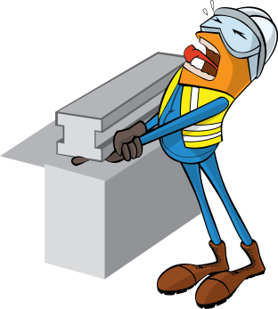
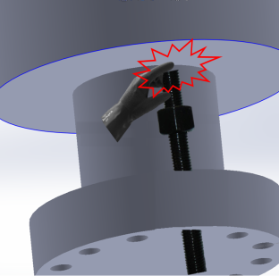
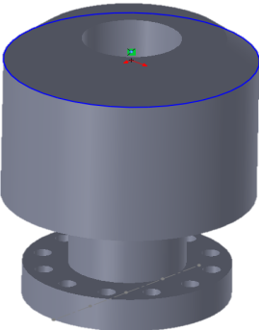
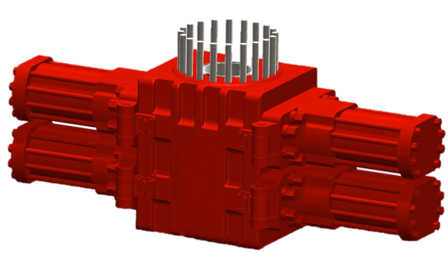
PDO Safety Advice
Use this Advice: Discuss in Tool Box Talks and HSE Meetings ➔ Distribute to contractors ➔ Post on HSE Notice Boards
Date: 23/08/2015
Injury: Fractured fingers
What happened?
While crew members were rigging up blow out preventer the Derrick man adjusted the preventer fitted with an upright stud. On lowering preventer to fit on the upright stud, the loose stud lifted up, trapping the derrick man’s left hand fracturing his index finger.
Your learning from this incident:
Ensure procedures are up to date and appropriate to site arrangements.
Ensure PTW requirements are correctly followed as per responsibilities.
Identify task hazards and discuss controls.
Ensure that competent supervision is in place for HSE critical tasks.
Provide safe place to work – platform / access etc.
Inspect all equipment for system integrity and potential pinch pints
Contact MSE34 for further information Learning No 43 23/08/2015

Slide 2
Management learning's
Distribute to contractors ➔ Post on HSE Notice Boards
Date: 23/08/2015
Injury: Fractured fingers
As a learning from this incident and to ensure continual improvement all
contract managers are to review their HSE HEMP against the questions
asked below:
Confirm the following:
Are your employees aware of pinch points?
Are they trained for hand off operational technique?
Do you implement close supervision on all HSE critical tasks?
Is your SOP & HEMP document reviewed periodically for updates on hazards recognized as part of investigation findings?
Have you completed the PTW system Audit, is PTW system effectively implemented?
Contact MSE34 for further information Learning No 43 2308/2015

