Slide 1

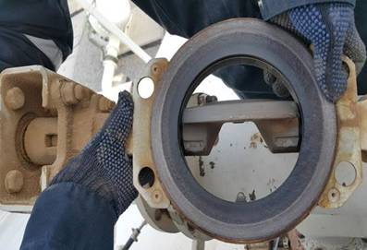
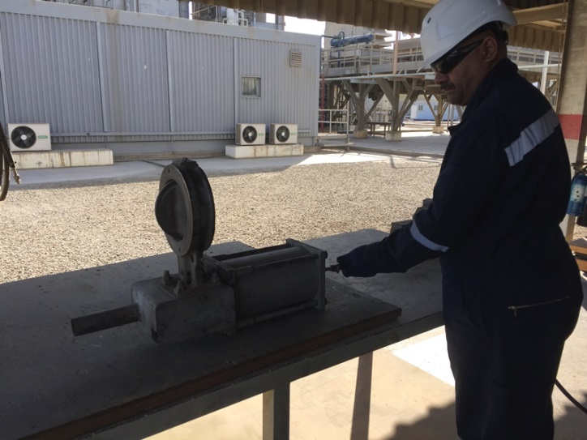
PDO Safety Advice
Use this Advice: Discuss in Tool Box Talks and HSE Meetings ➔ Distribute to contractors ➔ Post on HSE Notice Boards
Finger pinch point
Open valve gate
Date: 11/08/2015
Injury: Amputated fingers
What happened?
A crew was conducting function tests on a valve on a roof top. A mechanic on the roof had his fingers in the valve as he attempted to reposition the valve. The engineer on the roof shouted to the technician at ground level to position himself nearer to the isolation valve ready to activate it, but the technician misunderstood the instruction and instead operated the valve. This caused the valve to close amputating the tips of two of his fingers.
Valve body
Learning from this incident…
Never compromise safety for production
Ensure you do not bypass the PTW controls
Always follow management of change procedure
Always ensure effective communication
Always ensure clear communication between operators
Contact MSE34 for further information Learning No 46 11/08/2015

Slide 2
Management learning's
Distribute to contractors ➔ Post on HSE Notice Boards
Date: 11/08/2015
Injury: Amputated fingers
As a learning from this incident and to ensure continual improvement all
contract managers are to review their HSE HEMP against the questions
asked below:
Confirm the following:
Are all your activities, controls and consequences covered in your HEMP?
Do you have controls to avoid management shortfalls at site?
Do you always comply with PTW system?
Do you ensure your workers are given adequate rest between shifts?
Contact MSE34 for further information Learning No 46 11/08/2015

