Slide 1

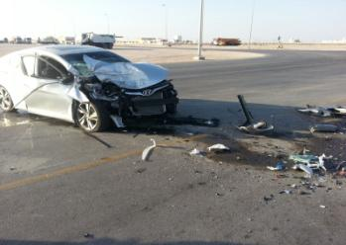

PDO Incident First Alert – (Private vehicle)
Incident type | Fatal Private Commuting (#05) | PIM ID | 1091860
Date/ time | 17/12/2015 (15:50hrs) | Directorate
Location | Ghaba north junction | Dept
What happened?
Two contractor colleagues were travelling from Qarn Alam in a private vehicle on the Muscat Salalah highway. As they approached the junction for Ghaba north they collided with the rear of a trailer moving into the deceleration lane to turn left into the Ghaba rest area. Due to the severity of the collision, the passenger passed away at the scene and the driver suffered multiple fractures. Our thoughts are with the families of the deceased and injured.
Mr. Musleh asks the questions of can it happen to you?
Do you need to risk commuting using your private vehicle?
Do you take passengers with you?
Do you break the speed-limit when you drive your own private vehicle?
Do you and your passengers always wear seatbelts?
Please disseminate this notification to your teams and use it in your tool box talks and HSE meetings and notice boards.

