Slide 1
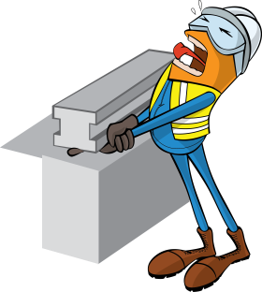
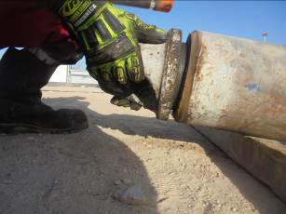


PDO Incident First Alert
Incident type | LTI (#49) | PIM ID | 1091855
Date/ time | 19/12/2015 (20:00 hrs) | Directorate
Location | Suwaihat | Dept
What happened
During rig up of 12 ¼’’ Bottom Hole Assembly (BHA), the Roustabout was installing 6 5/8” lifting cap on a stabilizer. Suddenly the lifting cap slipped from his hand and fell down onto his right index finger crushing it. Although there was no cut to his finger he has sustained a fracture to his right index finger.
Mr. Musleh asks the questions of can it happen to you?
Stabilizer
lifting cap
Do you always pay attention to the task at hand?
Do you ensure the equipment is in the correct position?
Do you consider pinch points?
Please disseminate this LTI notification to your teams and use it in your tool box talks and HSE meetings and notice boards.

