Slide 1
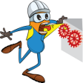
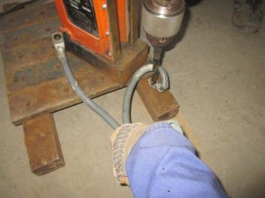
PDO Incident First Alert
Incident type | LTI (#50) | PIM ID | 1092001
Date/ time | 30/12/2015 (09:52 hrs) | Directorate
Location | Marmul | Dept
What happened
A fitter was operating a magnetic drilling machine to enlarge a hole connected to a flexible cable. He was holding the cable with his left hand and operating the drilling machine with his right hand while operating the drill on the floor. The drill bit got stuck in the hole resulting in the cable rotating around the drill bit, pulling his left hand around the machine resulting in a fractured forearm.
Mr. Musleh asks the questions of can it happen to you?
Do you always secure the object when drilling?
Do you ensure your equipment is properly positioned and secure before operating?
Do you keep your hand and fingers out of the line of fire?
Please disseminate this LTI notification to your teams and use it in your tool box talks and HSE meetings and notice boards.

