Slide 1
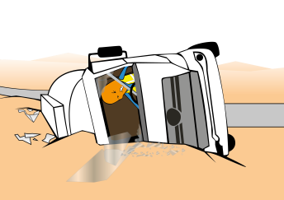
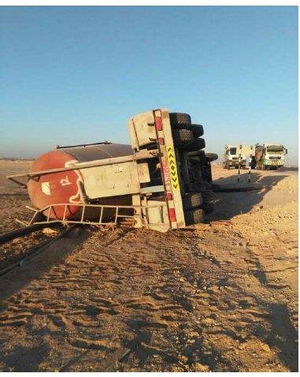


PDO Incident First Alert
Incident type | LTI (#51) | PIM ID | 1091962
Date/ time | 30/12/2015 (20:30hrs) | Directorate
Location | Lekhwair | Dept
What happened
A contractor tanker was moving from Fahud to Lekhwair on a graded road at night when the driver lost control of the vehicle and rolled over onto its left side. This resulted in the driver being thrown from the vehicle suffering a fracture to his right arm and left shoulder.
Mr. Musleh asks the questions of can it happen to you?
Do you take the risk by driving in the desert at night ?
Do you continue driving when fatigued ?
Do you always wear your seatbelt ?
Please disseminate this LTI notification to your teams and use it in your tool box talks and HSE meetings and notice boards.

