Slide 1
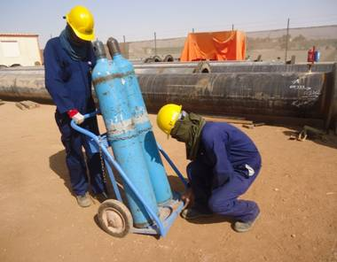
PDO Incident First Alert
Incident type | LTI(#01) | PIM ID | 1092003
Date/ time | 03/01/2016 (10:35 hrs) | Directorate
Location | Bahja | Dept
What happened
A four man team were unloading of a mobile cylinder trolley from a vehicle. As they placed it on the ground one of the team had his hand between the bottom of the trolley & the ground crushing his right hand little finger resulting in the tip being amputated.
Mr. Musleh asks the questions of can it happen to you?
Do keep your hands and fingers away from crush points?
Can this be done with mechanical aids?
Ensure you stay out of the “Line of Fire”
Please disseminate this LTI notification to your teams and use it in your tool box talks and HSE meetings and notice boards.

