Slide 1
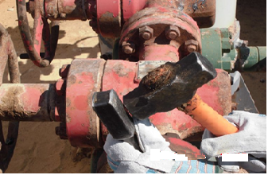
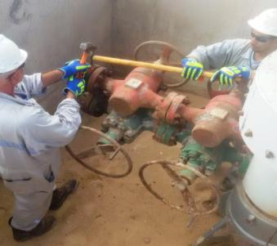
PDO Safety Advice
Use this Advice: Discuss in Tool Box Talks and HSE Meetings ➔ Distribute to contractors ➔ Post on HSE Notice Boards
Date:22.10.2015
LTI: Fractured thumb
What happened?
During rigging up, an assistant was opening the flange bolts using a wrench and hammer inside the cellar. While hammering with right hand he was holding the wrench with left hand. After hammering a couple of times, the assistant’s right leg slipped on the uneven sands and as a result he lost balance causing the hammer to deviate and hit his left thumb resulting in a fractured thumb.
Your learning from this incident:
Ensure a finger saver tool is available and used.
Ensure impact gloves are used to reduce the effect of such injuries.
If the tools/equipments are not suitable for the job, STOP and conduct a risk assessment.
Stay out of the “Line of Fire”
Stay out of the “Line of Fire”
Contact MSE34 for further information Learning No 51 22/10/2015

Slide 2
Management learning's
Distribute to contractors ➔ Post on HSE Notice Boards
Date:22.10.2015
LTI: Fractured thumb.
As a learning from this incident and to ensure continual improvement all contract managers are to review their HSE HEMP against the questions asked below:
Confirm the following:
Do you ensure the correct tools are provided prior to the task?
Do you ensure your crew are implementing hands-off methodology?
Do you ensure effective onsite supervision is provided to the inexperienced hands?
Contact MSE34 for further information Learning No 51 22/10/2015

