Slide 1

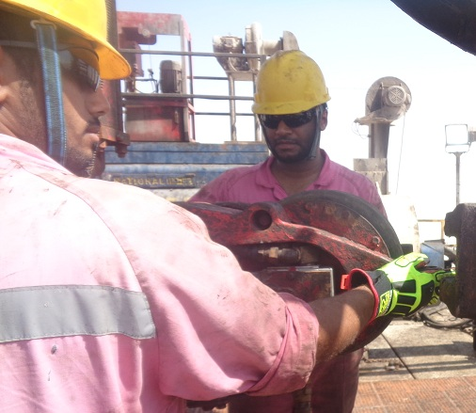
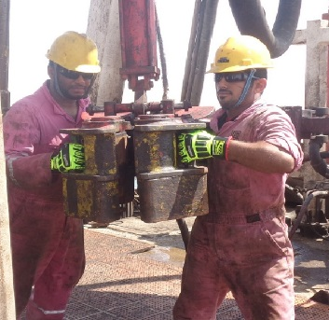
PDO Safety Advice
Use this Advice: Discuss in Tool Box Talks and HSE Meetings ➔ Distribute to contractors ➔ Post on HSE Notice Boards
Date:26.10.2015
LTI: Finger injury
What happened?
The Operation was making 5‘’ DP connection into mouse hole using the pipe spinner. The two floor men involved were in the process of latching the pipe spinner on drill pipe. The pipe spinner was not fully engaged on drill pipe and swung back, trapping the floorman’s right hand between the rear side of pipe spinner and the manual tong handle.
Your learning from this incident:
Ensure hands and fingers are kept away from pinch points
Ensure correct PPE is provided and used
Ensure you follow the work instructions/procedures
Intervene and STOP if you witness unsafe acts
Stay out of the “Line of Fire”
Always use proper handles of the pipe spinner
Contact MSE34 for further information Learning No 52 26/10/2015

Slide 2
Management learning's
Distribute to contractors ➔ Post on HSE Notice Boards
Date:26.10.2015
LTI: Finger injury.
As a learning from this incident and to ensure continual improvement all contract managers are to review their HSE HEMP against the questions asked below:
Confirm the following:
Do you ensure all hazards are identified for each task?
Do you ensure hands and fingers related hazards are effectively addressed?
Do you monitor compliance with TRIC, Job Safety Procedures & Job Safety Analysis?
Do you ensure these topics/issues are adequately covered in your TBT’s ?
Contact MSE34 for further information Learning No 52 26/10/2015

