Slide 1
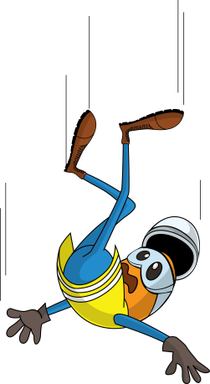
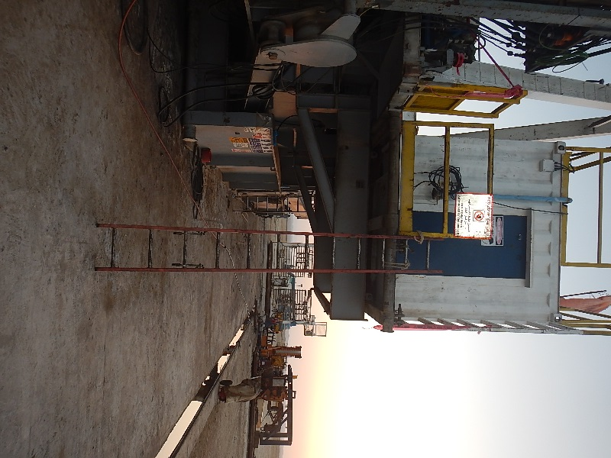
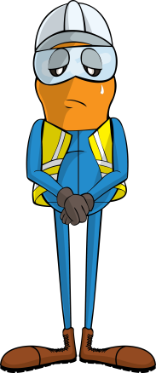
PDO Incident First Alert
Incident type | LTI(#03) | PIM ID | 1092392
Date/ time | 13/02/2016 (16:00 hrs) | Directorate
Location | Khulud West | Dept
What happened
An electrician was climbing up a ladder to the lower rig floor when the ladders securing ties snapped. The ladder slipped backwards causing him to fall 1.5 metres and fracturing his foot when he hit the ground.
Tie point
Mr. Musleh asks the questions of can it happen to you?
Is the ladder an appropriate safe access?
Are all your ladders secure before climbing?
Do you have someone foot your ladder?
Please disseminate this LTI notification to your teams and use it in your tool box talks and HSE meetings and notice boards.

