Slide 1
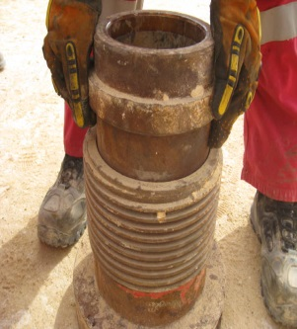
PDO Incident First Alert
Incident type | LTI(#04) | PIM ID | 1092519
Date/ time | 24/02/2016 (23:15 hrs) | Directorate
Location | Amal | Dept
What happened
A Roustabout was manually lifting a mud pump liner from its retainer when he lost his grip and it slipped down trapping his finger and causing the tip of his finger to be sliced off.
Mr. Musleh asks the questions of can it happen to you?
Mud Pump
liner retainer
Do keep your hands and fingers out of the line of fire?
Do you use the correct tools for the job?
Do you intervene if you see people taking short cuts?
Mud Pump liner (15 kg)
Please disseminate this LTI notification to your teams and use it in your tool box talks and HSE meetings and notice boards.

