Slide 1
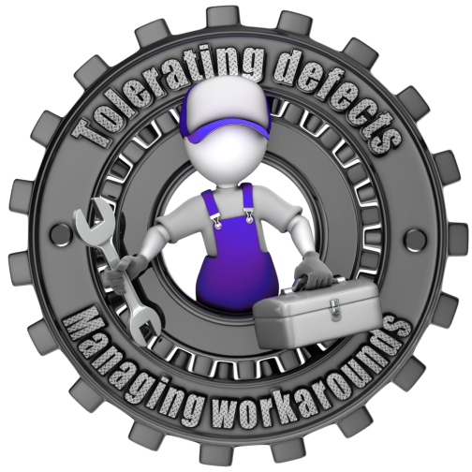
Workplace Safety Engagement Pack 2016 Edition 1
Work Stoppage

Slide 2
In 2015
PDO lost two lives in
two separate incidents.
Both were using
broken equipment
instead of getting it
repaired immediately.

Slide 3
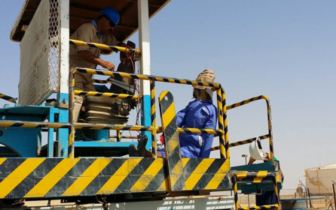
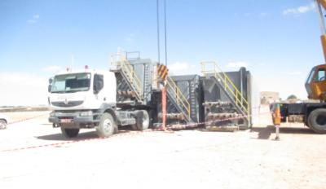
Al Turki fatality – 9th March 2015
IPC Fatality – 17th November 2015
Standing on a moving vehicle deploying a water hose the operator lost his balance, fell backwards and hit his head on a post. He should have been sitting but because the horn to warn the driver to stop when the hose was deployed was broken he had to stand to wave to the driver. The horn had been broken for a long time.
The man pulled the handle of the truck’s 5th wheel locking release but it kept going back in and hence would not stay unlocked. So he kept hold of the handle as the truck drove out from under the tank. The tank whose weight was suspended by a crane swung sideward's as the truck moved out crushing him against another tank.
Broken horn
Broken handle

Slide 4
Why did they die?
The horn and the handle had not just broken, they had not broken
that day, or that week. They had been broken for a long time.
The people had managed to find another way of working to
work with the broken equipment
wHY?
It was the easiest path rather than waiting for the repairs to be
made and losing productivity and time.

Slide 5
Why did they die?
The ‘new’ unofficial way then became the
‘new’, accepted way
of the job being done
Custom and practice
That’s when people get injured

Slide 6
How often in the past when something
broke did you
‘Improvise’
Saying
“I can work with this problem !!”
Some might call it
‘Being clever’

Slide 7
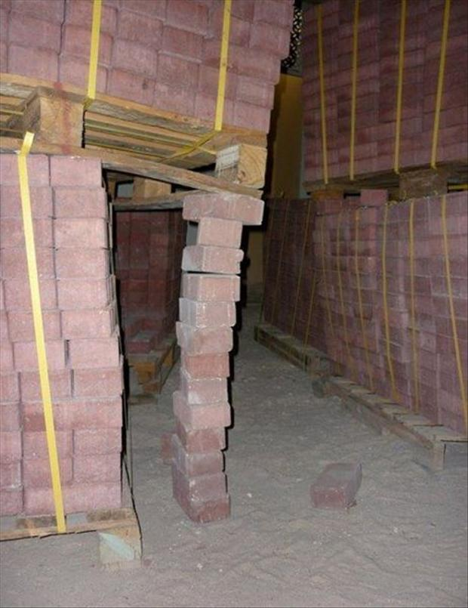
Often, it is far from clever

Slide 8
Get it repaired straight away and don’t ‘improvise’

