Slide 1
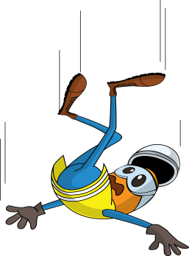
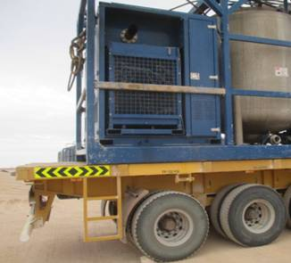
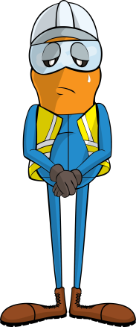
PDO Incident First Alert
Incident type | LTI(#05) | PIM ID | 1092518
Date/ time | 24/02/2016 (16:15 hrs) | Directorate
Location | Saih Rawl | Dept
What happened
While offloading a batch mixer from a trailer a driver was trying to hook the crane sling on to lifting ring on the batch mixer. As he reached over he grabbed a bar on the mixer for balance but this broke off causing him to lose his balance and fall to the ground fracturing his left ankle.
Mr. Musleh asks the questions of can it happen to you?
Do you use a working platform when working at height?
Do you always consider how you can fall from height?
Have you asked how you are to access height safely?
The unsecured bar he IP used to support himself.
Please disseminate this LTI notification to your teams and use it in your tool box talks and HSE meetings and notice boards.

