Slide 1
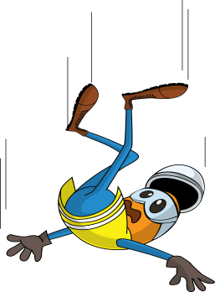
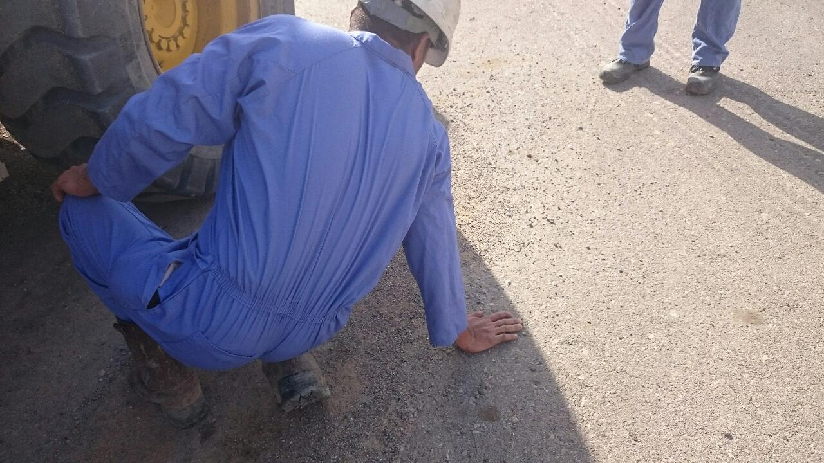
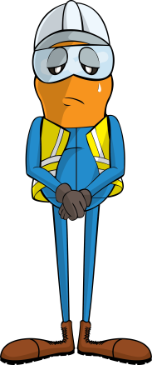
PDO Incident First Alert
Incident type | LTI(#05) | PIM ID | 1092720
Date/ time | 12/03/2016 (07.45hrs) | Directorate
Location | Fahud | Dept
What happened
A fork lift operator was climbing down from his cab using the 3 steps on the side of the fork lift but he lost his balance whilst on the second step and fell to the ground. He stretched out his arm to regain his balance but as he landed his wrist fractured.
Mr. Musleh asks the questions of can it happen to you?
Do you use always pay attention when climbing down from a vehicle?
Do you always use all the steps?
Do you always keep 3 points of contact when climbing down?
Please disseminate this LTI notification to your teams and use it in your tool box talks and HSE meetings and notice boards.

