Slide 1
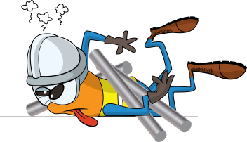
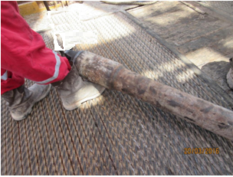
PDO Incident First Alert
Incident type | LTI(#06) | PIM ID | 1092764
Date/ time | 17/03/2016 (04.45hrs) | Directorate
Location | Sakhyia 36, Harweel | Dept
What happened
An assistant driller opened the lock on the rig elevator to release a 60kg, 5” pup joint without using the winch to support its weight. The floorman who tried to hold the pup joint when the elevator released it could not hold its weight and it tipped over on to the rig floor landing on his foot.
Mr. Musleh asks the questions of can it happen to you?
Do you ensure equipment is secure and stable before releasing supports?
Do you always plan and sequence the job correctly?
Do you keep out of the line of fire?
Pup joint final landing place
Please disseminate this LTI notification to your teams and use it in your tool box talks and HSE meetings and notice boards.

