Slide 1
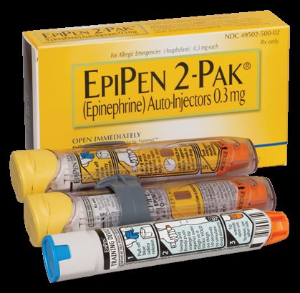
PDO Safety Advice
Use this Advice: Discuss in Tool Box Talks and HSE Meetings ➔ Distribute to contractors ➔ Post on HSE Notice Boards
Date : 06/11/2015
Injury: Non Accidental Death
What happened?
A contractor colleague with a known allergy to seafood decided to eat prawns on a lunch out with a group of friends. Within minutes he experienced breathing difficulties and collapsed. They drove him to the clinic, but despite continual CPR they were unable to revive him. He died from a anaphylactic shock.
Your learning from this incident...
Never eat food you are allergic to and don’t let your friends do the same.
If you have a food allergy always have your EpiPen with you
When eating out, let the person serving you know your food allergy.
Always check what is in the food you are eating if you have allergies.
Someone having a severe allergic reaction, call 5555 for an ambulance and a paramedic.
If you have suspicion about a food dish you have been provided,
don’t eat it, don’t risk it!
Contact MSE34 for further information Learning No 47 06/11/2015

Slide 2
Management learning's
Distribute to contractors ➔ Post on HSE Notice Boards
Date: 06/11/2015
Injury: Non Accidental Death
As a learning from this incident and to ensure continual improvement, all contract managers are to review their HSE HEMP against the questions asked below.
Confirm the following:
Do you spread awareness of food allergy prevention?
Do your staff know about EpiPens for food allergies?
Are your management team aware of staff with food allergies?
Does your pre employment medical ask about allergies?
Do your catering staff prepare food from unofficial suppliers?
Does your menu contain the ingredients of food highlighting main common allergy foodstuffs?
Contact MSE34 for further information Learning No 47 06/11/2015

