Slide 1
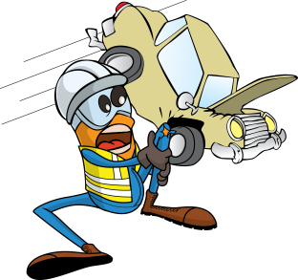
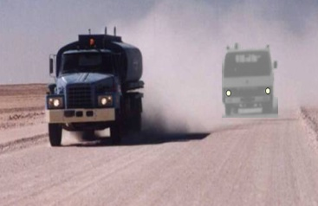
PDO Safety Advice
Use this Advice: Discuss in Tool Box Talks and HSE Meetings ➔ Distribute to contractors ➔ Post on HSE Notice Boards
Date: 03/10/2015
Injury: Multiple fractures
What happened?
A Mitsubishi Canter truck was driving behind a heavy truck that generated a large dust cloud reducing visibility. The driver of the Canter truck pulled out into the left lane and was involved in a head on collision with a water tanker moving on the opposite direction resulting in multiple fractures.
Your learning from this incident…
Avoid driving in dust clouds.
If you cannot avoid:
Slow down
Keep a safe distance (at least four seconds) from the rear end of the dust.
If visibility is still low, pull over in a safety lane
Do not overtake in a dust cloud under any circumstances.
Never Drive into Dust
Contact MSE34 for further information Learning No 48 03/10/2015

Slide 2
Management learning's
Distribute to contractors ➔ Post on HSE Notice Boards
Date: 03/10/2015
Injury: Multiple fractures
As a learning from this incident and to ensure continual improvement, all contract managers are to review their HSE HEMP against the questions asked below.
Confirm the following:
Do you ensure your contractors manage their subcontractors?
Do you ensure adequate time is allocated for the journey?
Is your SJM able to communicate with drivers at all times?
Do you ensure your drivers attended the refresher training DD03?
Contact MSE34 for further information Learning No 48 03/10/2015

