Slide 1
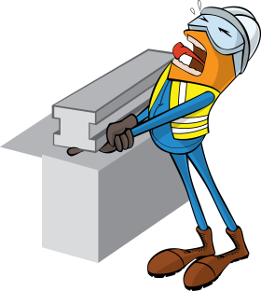
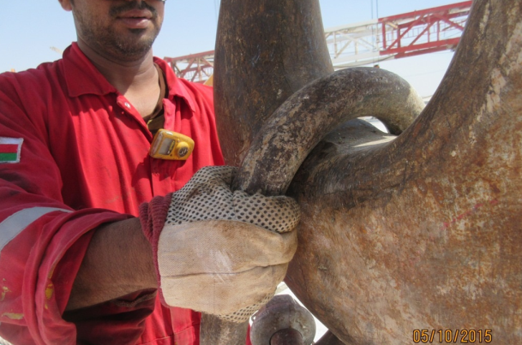
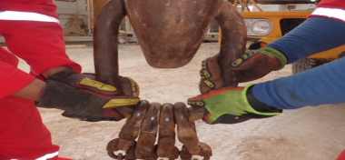
PDO Safety Advice
Use this Advice: Discuss in Tool Box Talks and HSE Meetings ➔ Distribute to contractors ➔ Post on HSE Notice Boards
Date: 04/10/2015
Injury: Fractured finger
What happened?
During a rig up operation a Roustabout was installing the D-Ring onto the crane hook. While lifting the D-ring onto the hook, he got his right middle and ring finger crushed in between the D-Ring and the hook resulting in fractured fingers.
Your learning from this incident..
Ensure you use 2 people or mechanical aids to lift awkward items.
If in doubt, STOP the job and ask for help.
Use impact gloves where needed to reduce the seriousness of crush injuries.
Ensure you attend and pay attention to the toolbox talk (TBT) before starting any tasks.
Speak to your supervisor before starting any task
Contact MSE34 for further information Learning No 49 04/10/2015

Slide 2
Management learning's
Distribute to contractors ➔ Post on HSE Notice Boards
As a learning from this incident and to ensure continual improvement, all contract managers are to review their HSE HEMP against the questions asked below.
Confirm the following:
Does your team follow the 4 hand and fingers questions prior to starting a task?
Does your STOP / Intervene program flow both ways?
Do your workers perform tasks without prior instructions?
Do you ensure all staff attend and understand the TBT’s?
Contact MSE34 for further information Learning No 49 04/10/2015

