Slide 1

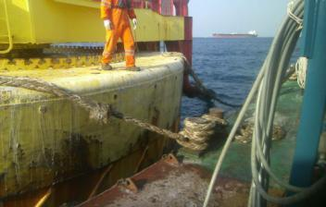
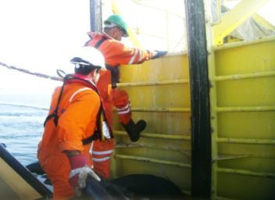
PDO Safety Advice
Use this Advice: Discuss in Tool Box Talks and HSE Meetings ➔ Distribute to contractors ➔ Post on HSE Notice Boards
Date: 19/10/2015
Injury: Twisted knee
What happened?
A maintenance worker had completed washing down a buoy from an offshore installation and attempted to cross a gap from the buoy to a barge. Due to the tide and sea current the difference in height was 1.2m and the gap was 0.5m. The worker jumped onto the barge deck landing badly twisting his left knee.
Your learning from this incident..
Are you aware of the safe transfer between work areas?
Are you fit for your work?
Do you report all incidents to management?
Do you conduct dynamic risk assessments to manage change?
Don’t take short cuts!
Contact MSE34 for further information Learning No 50 19/10/2015

Slide 2
Management learning's
Distribute to contractors ➔ Post on HSE Notice Boards
Date: 19/10/2015
Injury: Twisted knee
As a learning from this incident and to ensure continual improvement, all contract managers are to review their HSE HEMP against the questions asked below.
Confirm the following:
Do you always report incidents?
Do staff update management /supervisors that they are fit to work?
Can your staff do a dynamic risk assessment?
Can supervisors manage incremental change?
Are your staff empowered to STOP work?
Contact MSE34 for further information Learning No 50 19/10/2015

