Slide 1
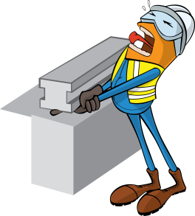
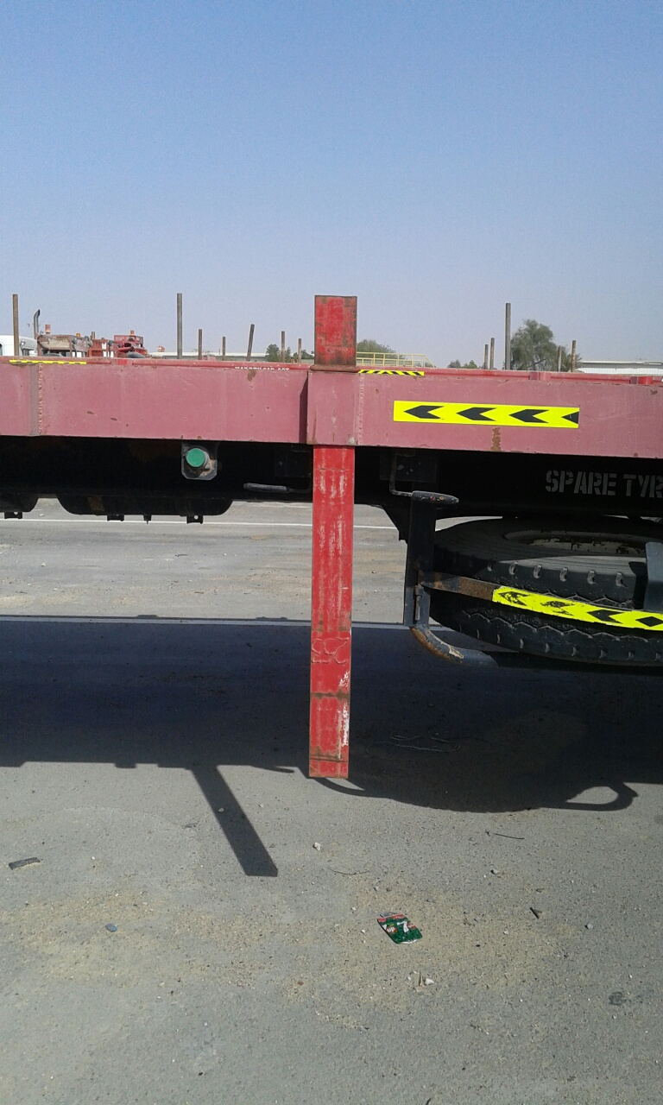
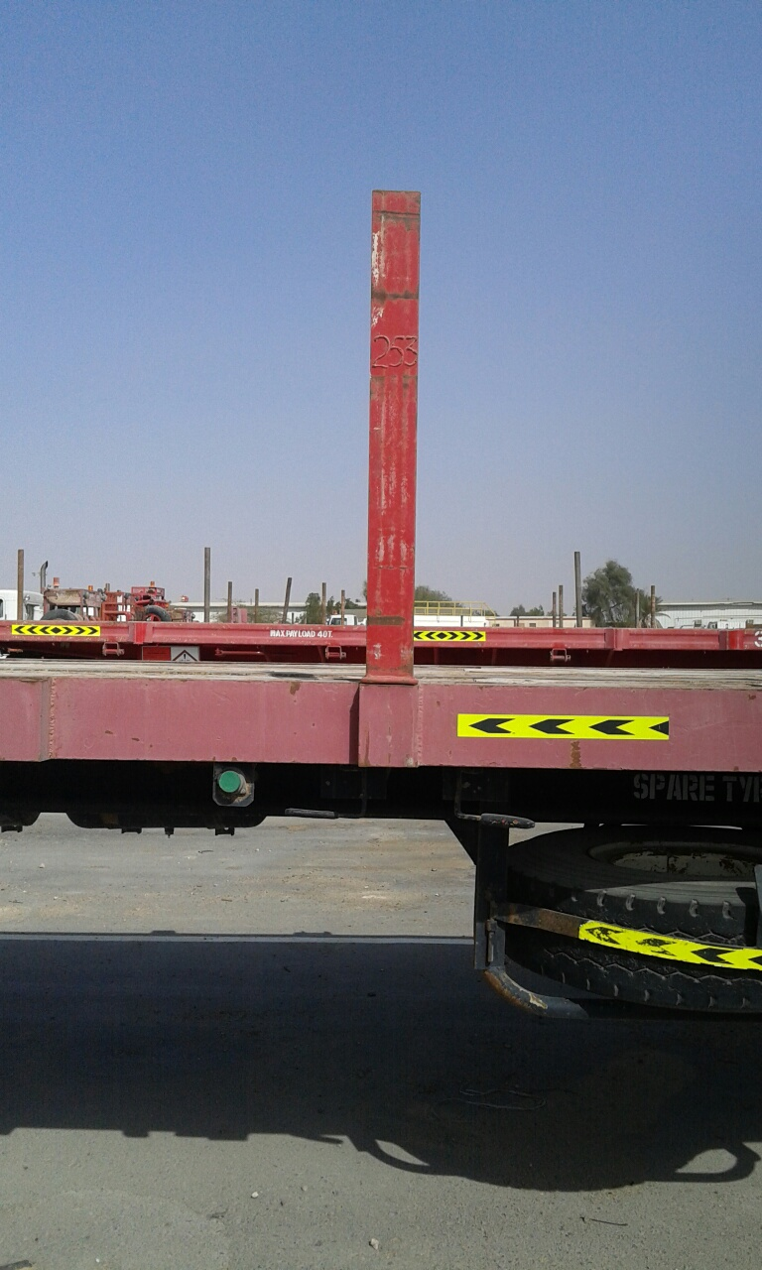
PDO Safety Advice
Use this Advice: Discuss in Tool Box Talks and HSE Meetings ➔ Distribute to contractors ➔ Post on HSE Notice Boards
Date: 02.11.2015
LTI: Finger Injury
What happened?
After loading some items onto a trailer, a helper started to fit the side stanchions. He was placing the second side stanchion upside down by mistake when he sustained a pinch injury to his right index finger. The IP sustained a fracture and cut to his index finger.
Your learning from this incident…
Ensure your staff are adequately supervised.
Multiple contractors working together must have adequate handover and supervision.
Ensure staff receive TBT’s and understand the task in hand.
Ensure stanchions are the correct way up before placing into the support.
Keep hands and fingers clear of pinch points.
Always pay attention to the task in hand.
Ensure you wear the correct PPE (Impact gloves).
Do not carry out tasks without proper supervision and instruction.
Be aware of potential pinch points
Contact MSE34 for further information Learning No 53 02/11/2015

Slide 2
Management learning's
Distribute to contractors ➔ Post on HSE Notice Boards
Date: 02.11.2015
LTI: Finger Injury
As a learning from this incident and to ensure continual improvement, all contract managers are to review their HSE HEMP against the questions asked below.
Confirm the following:
Are you aware of what operations are being carried out on your site?
Are staff being adequately supervised?
Do your staff use the correct PPE for the task at hand?
Are pinch points clearly identified?
Are TBT’s carried out before operations?
Are your TBT’s recorded?
2
Contact MSE34 for further information Learning No 53 02/11/2015

