Slide 1
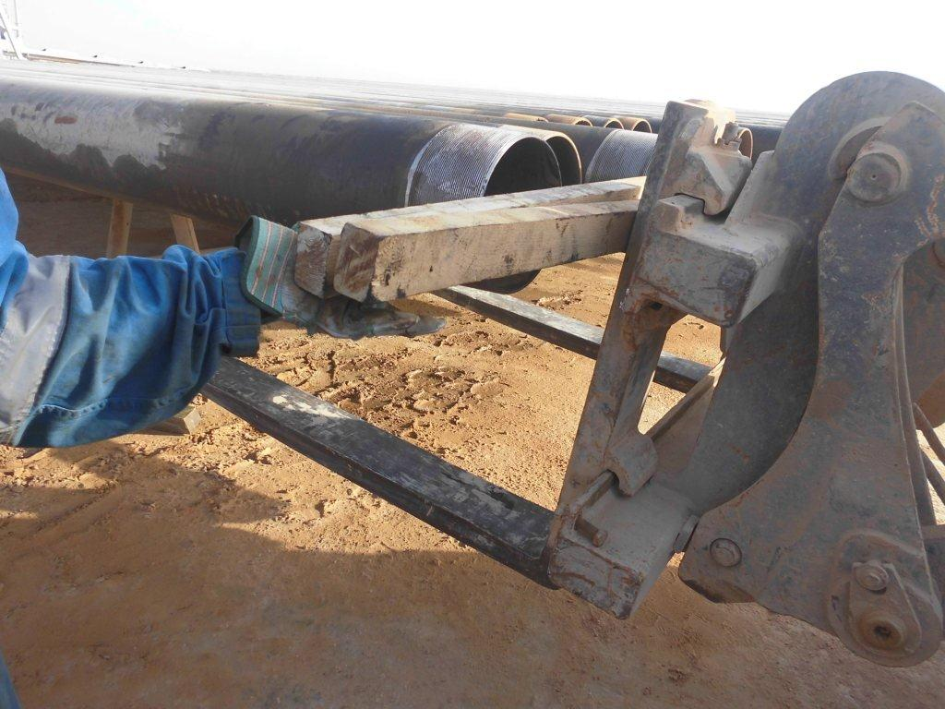
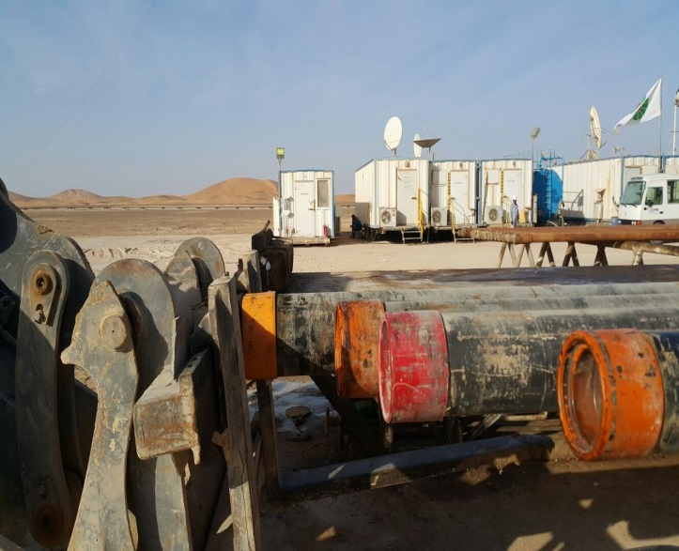
PDO Safety Advice
Use this Advice: Discuss in Tool Box Talks and HSE Meetings ➔ Distribute to contractors ➔ Post on HSE Notice Boards
Date: 08-12-2015
Injury: Fractured finger
What happened?
Whilst running 9 5/8” casing, a Roustabout on the ground noticed that 3 joints of casing on the pipe rack were misaligned with the catwalk stopper. He called the forklift operator to use the forklift to push the casings back into the correct order using 2 pieces of wood in order to prevent damage to the threads between the casing ends and the forklift. During this, he put his ring finger in between the wood and as the forklift has moved forward his ring finger was crushed resulting in a fracture.
Your learning from this incident:
Keep away from line of fire.
Use your empowerment to stop unsafe tasks.
Always use thread protector.
Ensure effective site supervision.
Ensure all activities related to RIH casing are discussed during TBT.
Always use the correct tools for the job don’t take shortcuts
Contact MSE34 for further information Learning No 57 08/12/2015

Slide 2
Management learning's
Distribute to contractors ➔ Post on HSE Notice Boards
Date: 08-12-2015
Injury: Fractured finger
As a learning from this incident and to ensure continual improvement, all contract managers are to review their HSE HEMP against the questions asked below.
Confirm the following:
Do you encourage your staff to intervene in unsafe practices?
Do supervisors control shortcut taking at the work site?
Do the direct supervisors know their roles and responsibilities?
How do you address the risk to crew members?
How effective is your TBT?
Contact MSE34 for further information Learning No 57 08/12/2015

