Slide 1
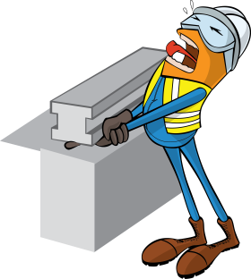
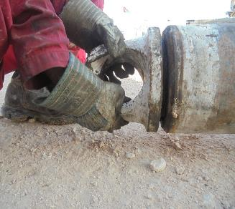
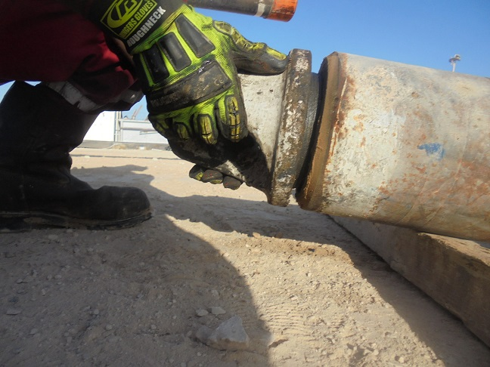
PDO Safety Advice
Use this Advice: Discuss in Tool Box Talks and HSE Meetings ➔ Distribute to contractors ➔ Post on HSE Notice Boards
Date:19-12- 2015
Injury : fractured finger
What happened?
While the roustabout was installing 6-5/8’’ lifting cap (7 kg weight) on 12-1/4’’ stabilizer at the ground level, the lifting cap suddenly dropped from a height of 6 cm, onto his right index finger tip against the ground.
Your learning from this incident:
Keep your hands and fingers away from pinch/crush point hazards.
Keep adequate clearance from the ground level while installing the lifting cap.
Always use the correct PPE (impact gloves) for the specific task.
Intervene and exercise empowerment to stop, if considered unsafe.
Keep your hands out of the line of fire
Contact MSE34 for further information Learning No 58 19/12/2015

Slide 2
Management learning's
Distribute to contractors ➔ Post on HSE Notice Boards
Date:19-12- 2015
Injury : Fractured finger
As a learning from this incident and to ensure continual improvement, all contract managers are to review their HSE HEMP against the questions asked below.
Confirm the following:
Do your Supervisors set a good example to identify the hazards and risks for the task?
Do your staff understand and identify dynamic pinch points?
Do your inspections/audits monitor and ensure effective implementation of impact gloves?
2
Contact MSE34 for further information Learning No58 19/12/2015

