Slide 1
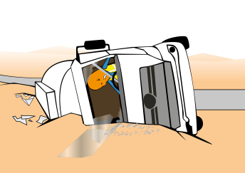
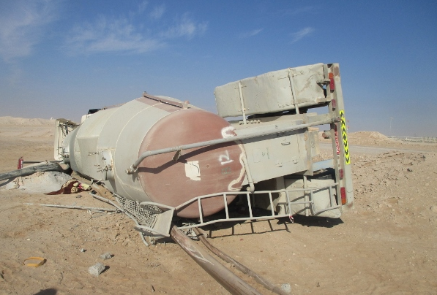
PDO Safety Advice
Use this Advice: Discuss in Tool Box Talks and HSE Meetings ➔ Distribute to contractors ➔ Post on HSE Notice Boards
Date: 30/12/2015
LTI: Motor vehicle incident
What happened?
A cementing banana HGV was driving on a graded road in the Lekhwair area at night having travelled from Fahud. Driver did not negotiate the graded road curve and went straight crossing the left edge of the graded road (1.1 meter above the adjacent desert) at a speed of 60 KPH. As a result of dropping wheels for more than one meter height, truck rolled over 90 degrees on to left side. Driver suffered lost time injuries.
Your learning from this incident..
Never Drive under influence of Alcohol.
Ensure all night journeys are approved.
Notify your Journey Manager if you are late departing on your journey.
Reduce your speed to suit the road condition.
Do NOT drive while taking alcohol or drugs
Contact MSE34 for further information Learning No 60 30/12/2015

Slide 2
Management learning's
Distribute to contractors ➔ Post on HSE Notice Boards
Date: 30/12/2015
LTI: Motor vehicle incident
As a learning from this incident and to ensure continual improvement, all contract managers are to review their HSE HEMP against the questions asked below.
Confirm the following:
Does your IVMS management resource and process allow for real-time management of violations?
Do you advise the drivers to inform Journey Managers when departing late?
Do your drivers receive interventions when they violate their SJP?
Do your SJM’s ask about Alcohol/Medication before the trip to confirm fitness to drive?
Contact MSE34 for further information Learning No 60 30/12/2015

