Slide 1
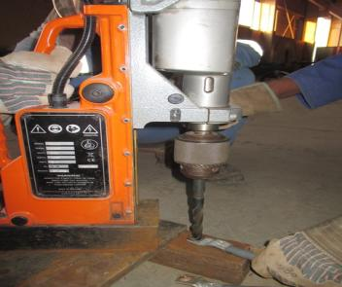
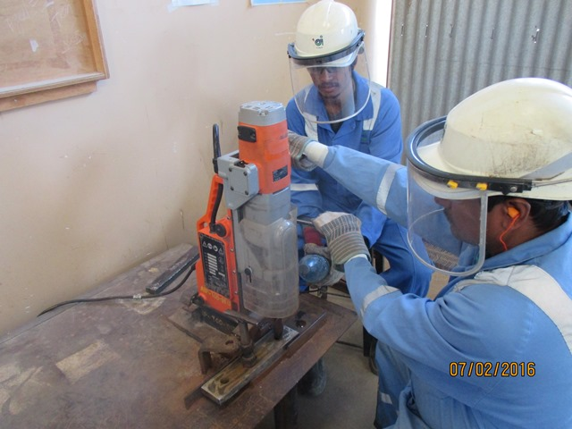
PDO Safety Advice
Use this Advice: Discuss in Tool Box Talks and HSE Meetings ➔ Distribute to contractors ➔ Post on HSE Notice Boards
Date: 30/12/2015
LTI: Fractured forearm
What happened?
A Fabricator was operating a magnetic drilling machine to enlarge a hole connected to a flexible cable. He was holding the cable with his left hand and operating the drilling machine with his right hand while operating the drill on the floor. The drill bit got stuck in the hole resulting in the cable rotating around the drill bit, pulling his left hand around the machine resulting in a fractured forearm.
Your learnings from this incident…
Always secure the object before starting any drilling activity.
Ensure that drilling machine is properly positioned and operated.
Always keep your hand and fingers out of the line of fire.
Never do any activity which you are not authorized to do.
Intervene and report if any unsafe action or condition noticed.
If in doubt seek advice from your supervisor.
Always secure the object before starting any drilling activity.
Contact MSE34 for further information Learning No 59 30/12/2015

Slide 2
Management learning's
Distribute to contractors ➔ Post on HSE Notice Boards
Date: 30/12/2015
LTI: Fractured forearm
As a learning from this incident and ensure continual improvement all contract
managers are to review their HSE HEMP against the questions asked below.
Confirm the following:
Are all activities inside the workshop happening as per the daily activity plan?
Are personnel aware about the line of communication in the workshop?
Are the workshop personnel accepting any work directly without supervisor’s knowledge?
Do you check to ensure that personnel are using tools & equipment correctly?
Do you always have the right size materials on stock?
Contact MSE34 for further information Learning No 60 30/12/2015

