Slide 1
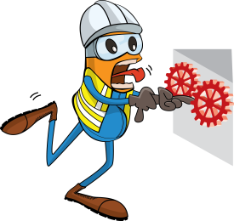
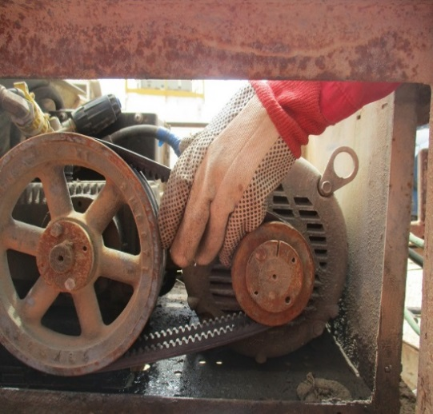
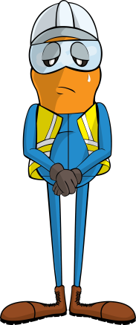
PDO Incident First Alert
Incident type | LTI(#07) | PIM ID | 1092975
Date/ time | 05/04/2016 | Directorate
Location | Barik -Rig 86 | Dept
What happened
An electrician and a work colleague were working on the wash gun machine. As the electrician was holding the machine’s rotary belt, the helper leant against the side of the machine and his leg accidently pressed against the “On” button. The rotary belt started to spin and pulled the electrician’s fingers into the pulley injuring two fingers on his left hand.
Mr. Musleh asks the questions of can it happen to you?
Do you make sure the equipment is isolated before you work on it?
Do you coordinate with your colleagues to keep safe?
Do you always comply with any PTW which is in place?
Finger trapping point
Please disseminate this LTI notification to your teams and use it in your tool box talks and HSE meetings and notice boards.

