Slide 1
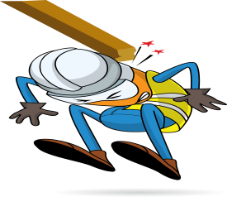
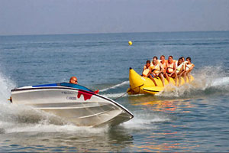
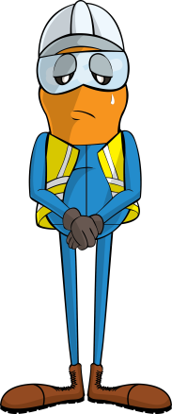
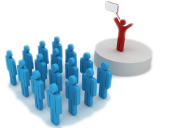
PDO Incident First Alert
Incident type | LTI(#08) | PIM ID | 1092970
Date/ time | 04/04/2016 | Directorate
Location | Bandar Al Khairan Beach | Dept
What happened
The team was on a team building “Away Day” and as part of the activities they went on an inflatable banana boat ride on the sea. Whilst being towed behind a speed boat the banana rolled over and threw people off. One person broke his nose when his head hit the water and his glasses cut into his face .
Mr. Musleh asks the questions of can it happen to you?
Do you always consider what might go wrong before any activity?
Do you remove your glasses before getting on a banana boat?
Do you always listen to the activity coordinator on how to keep safe?
Please disseminate this LTI notification to your teams and use it in your tool box talks and HSE meetings and notice boards.

