Slide 1
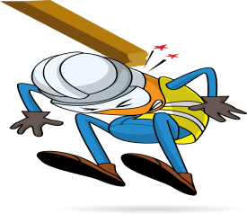
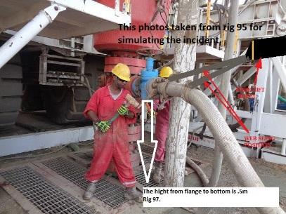
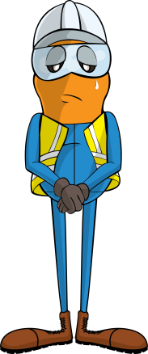

PDO Incident First Alert
Incident type | LTI(#09) | PIM ID | 1093151
Date/ time | 23/04/2016 | Directorate
Location | Rig 97 Nimr C station | Dept
What happened
Whilst dismantling the choke line from the BOP, the choke line flange was being supported by webbing slings attached to the boom on a fork lift. As the forklift pulled the choke line the flange slipped and fell onto the derrick man’s left foot fracturing his toe.
Mr. Musleh asks the questions of can it happen to you?
Do you ensure the correct equipment is used for the task?
Do you ensure all lifting operations procedures are adhered to?
Do you consider if you are ever in the ‘line of fire’?
Please disseminate this LTI notification to your teams and use it in your tool box talks and HSE meetings and notice boards.

