Slide 1
CARBON MONOXIDE
The Silent Killer

Slide 2
Some facts
Carbon Monoxide (CO) is:
  Colorless
  Odorless
  Tasteless
Each year many people die from CO poisoning.
CO can act on the body quickly in high concentrations, or slowly over long periods of time.
It takes several hours to remove CO from human body, low concentrations can gradually build up in the blood, causing anything from headaches, nausea, to even comas and death.
It can be formed when using equipment improperly or using malfunctioning equipment.
It inhibits the blood’s ability to carry oxygen to body tissues including vital organs such as the heart and brain. It takes about 5 hours for its levels in the blood to drop to half of its current level after exposure was terminated.

Slide 3
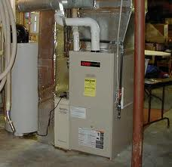
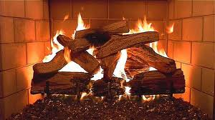
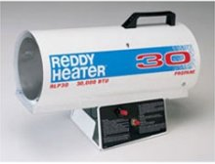
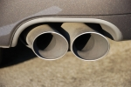
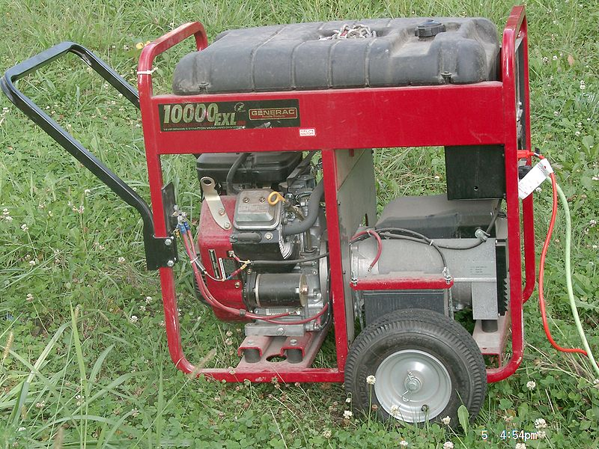
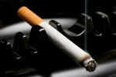
Common sources of CO
FIREPLACES
PORTABLE PROPANE HEATERS
WATER HEATERS & FURNACES
SMOKING INDOORS
PORTABLE GENERATORS
VEHICLE EXHAUST

Slide 4
CO Levels
Fresh air 0.06 - 0.5 ppm
Urban air 1 – 300 ppm
Smoke filled room 2 – 16 ppm
Cooking on gas stove 100 ppm
Actively smoking cigarette 400 – 500 ppm
Automobile exhaust 100,000 ppm

Slide 5
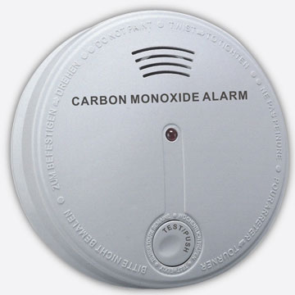
How to protect?
Awareness
Detection
Use CO detectors.
Fresh air
Ensure good air circulation.
Don’t use charcoal grills or run engines inside enclosed facilities.
Conduct drills to test emergency response.
Video 1
Video 2
Raise awareness within team and family about CO.

