Slide 1
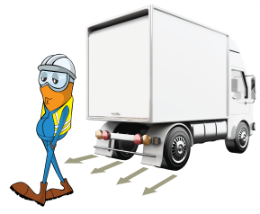
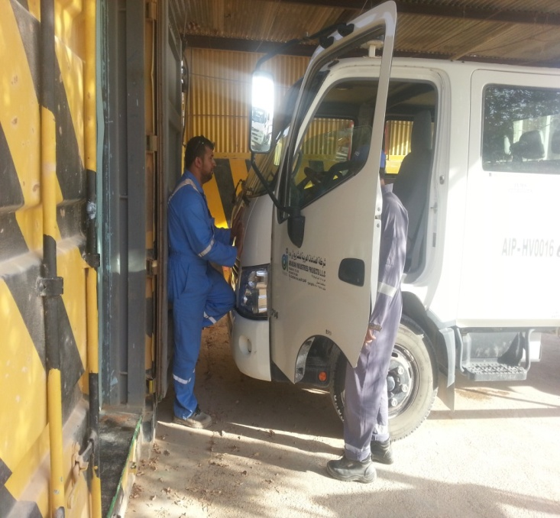
PDO Incident First Alert
Incident type | Crush Injury LTI (#11) | PIM ID | 1093253
Date/ time | 03/05/2016 (11:10 hrs) | Directorate
Location | Nimr | Dept
Position of injured person
What happened
A mechanic stood in a small gap between the front of a canter truck and the workshop door. A 2nd mechanic turned the ignition from outside the cab but as it had been left in gear it jerked forward crushing him dislocating his left hip, fracturing his pelvis and his left wrist.
Mr. Musleh asks the questions of can it happen to you?
Do you check that manual vehicles are out of gear before starting them?
Do you check in front and behind for potential hazards?
Do you consider if you are ever in the ‘line of fire’?
Person starting the vehicle
Please disseminate this LTI notification to your teams and use it in your tool box talks and HSE meetings and notice boards.

