Slide 1
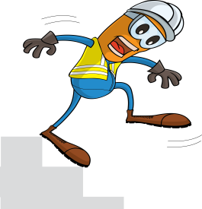
PDO Incident First Alert
Incident type | LTI (#14) | PIM ID | 1093249
Date/ time | 01/05/2016 (18:15 hrs) | Directorate
Location | Harweel | Dept
What happened
A camp helper was leaving his room when he lost his balance on the last step of the stairway falling to the ground resulting in a fracture to his right hip.
Mr. Musleh asks the questions of can it happen to you?
Do you check your footing when using steps?
Do you hold the hand rail when available?
Please disseminate this LTI notification to your teams and use it in your tool box talks and HSE meetings and notice boards.

