Slide 1
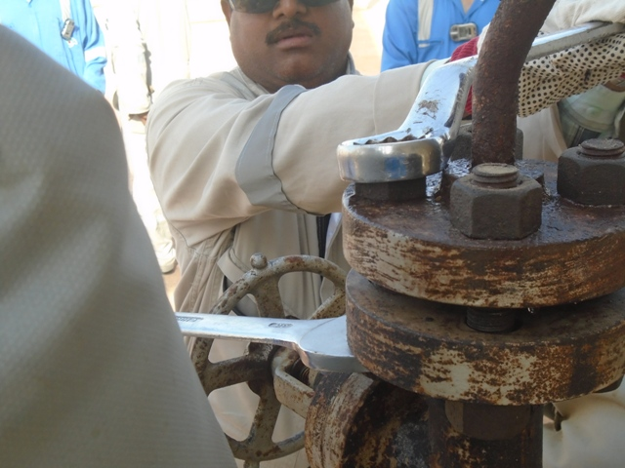
PDO Incident First Alert – PDO
Incident type | LTI (#15) | PIM ID | 1093700
Date/ time | 11/06/2016 (17:00 hrs) | Directorate
Location | Amal | Dept
What happened
Whilst loosening nuts on a flange using a ring spanner it slipped off the nut as the fabricator applied force to it, causing him to loose balance and fall to the ground fracturing his left wrist and right elbow.
Mr. Musleh asks the questions of can it happen to you?
Do you make sure the spanner fits correctly before loosening nuts?
Do you ensure that you have good balance when using tools?
Do you report defective tools immediately they are damaged?
Please disseminate this LTI notification to your teams and use it in your tool box talks and HSE meetings and notice boards.

