Slide 1
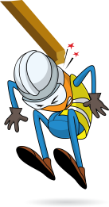
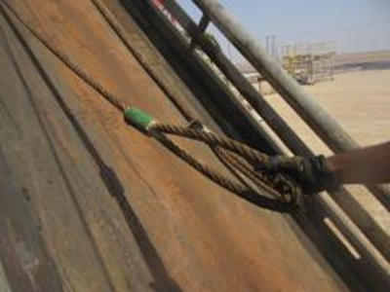
PDO Incident First Alert
Incident type | LTI (#16) | PIM ID | 1093806
Date/ time | 21/06/2016 (08:30 hrs) | Directorate
Location | Qarn Alam | Dept
What happened
A roustabout was straightening the wire rope on the catwalk, whilst holding the sling eye of the rope with 1 hand, as he pulled the rope, it untwisted and flipped onto his right hand resulting in a fracture.
Mr. Musleh asks the questions of can it happen to you?
Do you ensure that all slings are untangled before use?
Is all lifting equipment inspected prior to use?
Ensure you stay out of the “Line of Fire”
Please disseminate this LTI notification to your teams and use it in your tool box talks and HSE meetings and notice boards.

