Slide 1
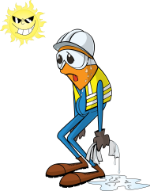
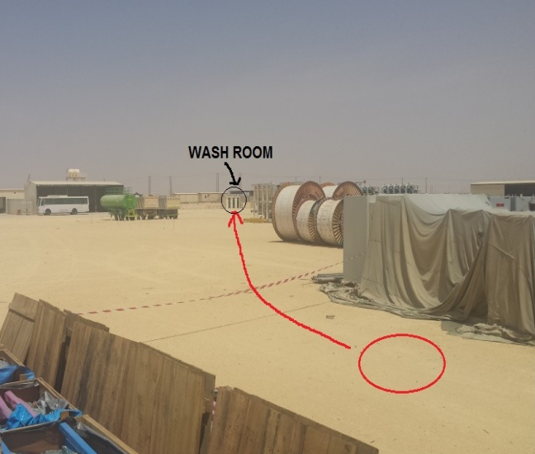
PDO Incident First Alert
Incident type | LTI (#17) | PIM ID | 1093812
Date/ time | 21/06/2016 (08:10 hrs) | Directorate
Location | Amal | Dept
What happened
A rigger was walking towards the washroom when he felt dizzy and fell down to the ground losing consciousness. A colleague witnessed this and rushed to his aid. The fall resulted in a fracture to his right wrist and a deep cut to his forehead.
Mr. Musleh asks the questions of can it happen to you?
Do you ensure that you have enough rest during Ramadan?
Do you ensure that you are adequately hydrated?
Please disseminate this LTI notification to your teams and use it in your tool box talks and HSE meetings and notice boards.

