Slide 1
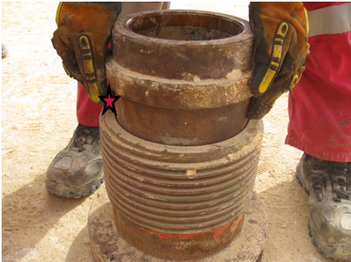
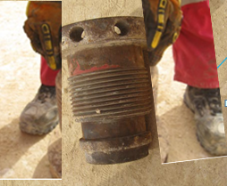
PDO Second Alert
Date: 24.02.16 LTI Rig 82
What happened?
A roustabout was changing a mud pump liner. Whilst lifting the liner from the retainer inside the mud pump liner box, one hand slipped and the liner dropped down trapping his right index finger between the top of the retainer and the shoulder of the liner amputating the tip of his finger.
Your learning from this incident..
Ensure Safe Working Procedures and risk assessments are followed at all times
Everyone involved must be part of the PTW, TBT and TRIC process.
If a new person joins the work crew, stop and hold another TBT
Always keep you hands and fingers out of the Line of Fire

Slide 2
Management self audit
Date: 24.02.16 LTI Rig 82
As a learning from this incident and to ensure continual improvement all contract managers must review their HSE HEMP against the questions asked below
Confirm the following:
Do your procedures for changing liners cover the use of mechanical lifting aids?
Do your procedures state the minimum level of supervision required?
Do you have a stop work authority program?
Are your procedures reviewed on a regular basis and followed?
Do your JHA / SOP’s contain the risks associated with the tasks at hand?
Notes:
Make a list of closed questions (only ‘yes’ or ‘no’ as an answer) to ask other contractors if they have the same issues based on the management or HSE-MS failings or shortfalls identified in the investigation. Pretend you have to audit other companies to see if they could have the same issues.

