Slide 1
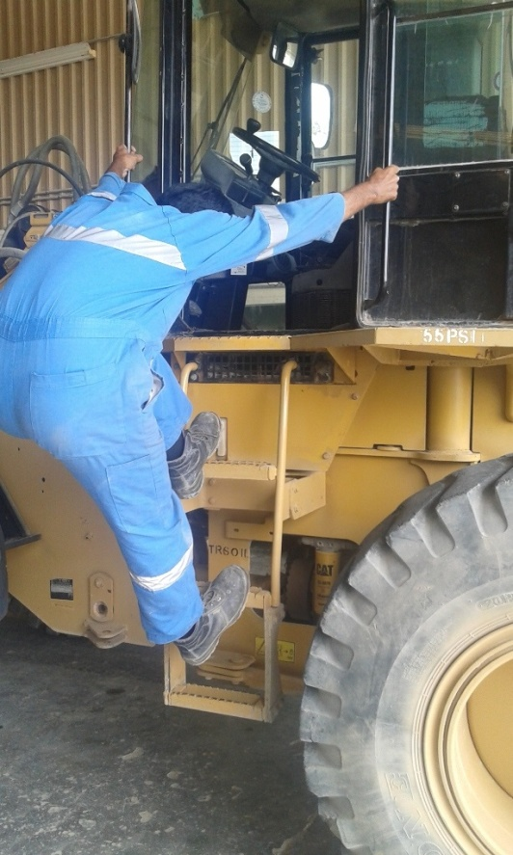
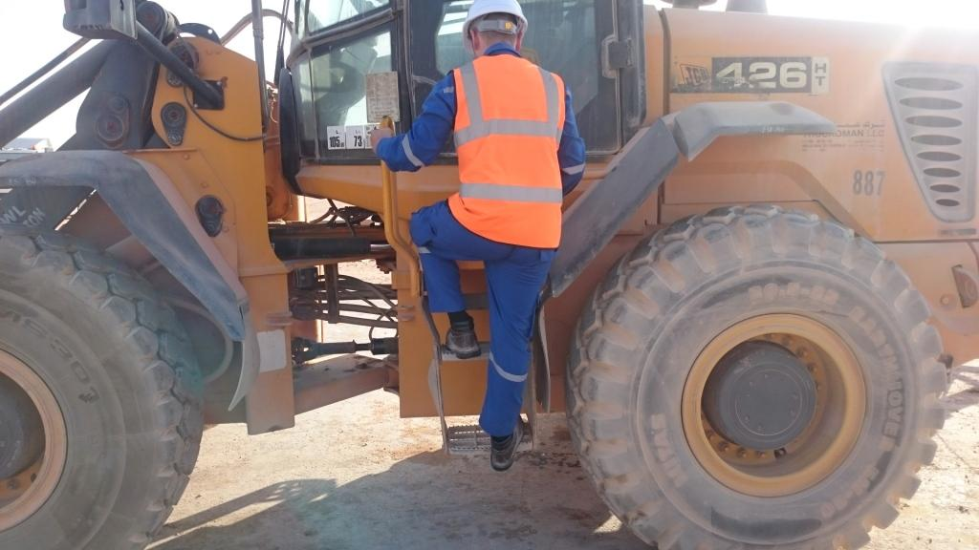
PDO Second Alert
Date: 12.03.16 LTI Fahud
What happened?
Whilst descending from a Forklift Truck cabin, an Operator slipped from the access ladder and fell to the ground landing on his right hand resulting in a fracture to his right wrist.
Your learning from this incident..
Always pay attention when climbing down from a vehicle
Always ensure you use all of the steps
Always keep 3 points of contact when climbing down
Always use 3 points of contact when using ladders

Slide 2
Management self audit
Date: 12.03.16 LTI Fahud
As a learning from this incident and to ensure continual improvement all contract managers must review their HSE HEMP against the questions asked below
Confirm the following:
Does your HEMP identify all hazards including routine tasks?
Do your TBT’s include reminding employees of concentrating on the task in hand?
Do you inspect employees PPE to ensure it is to an acceptable standard?
Do you conduct work observations to identify potential hazards?
Do you discuss the potential hazards of routine activities?
Notes:
Make a list of closed questions (only ‘yes’ or ‘no’ as an answer) to ask other contractors if they have the same issues based on the management or HSE-MS failings or shortfalls identified in the investigation. Pretend you have to audit other companies to see if they could have the same issues.

