Slide 1
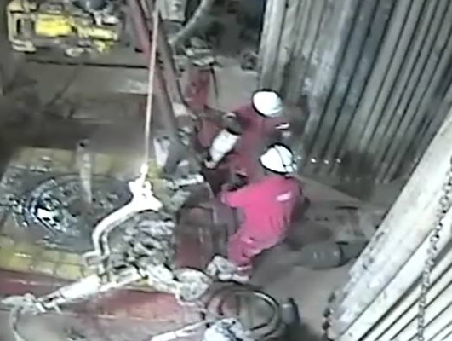
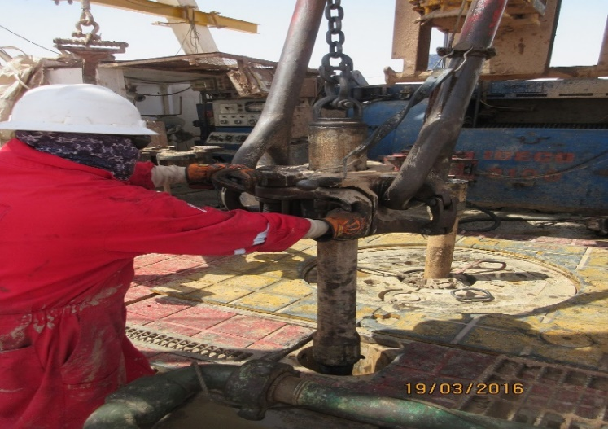
PDO Second Alert
Unsecured pup joint falling
Date: 17.03.16 LTI Rig 87
What happened?
After completion of BOP flushing, Driller and Floor hands broke out 5” pup joint. Driller lowered and tilted the elevator to unlatch pup joint. At the time driller lowered pup joint on Rig floor, Trainee Assistant Driller unlatched the elevator causing the pup joint to tilt on wear pushing and then bounced to floor man right foot resulting in a fracture of the right big toe.
Your learning from this incident..
Ensure all pup joints are secured and lifted by winch prior to unlatching the elevator
Always wear the correct size of safety boot
Housekeeping standards must be maintained at all times
Always intervene when you see unsafe act
Never take shortcuts
Secured with winch
Always secure pup joints by lifting cap & winch prior unlatching from elevator

Slide 2
Management self audit
Date: 17.03.16 LTI Rig 87
As a learning from this incident and to ensure continual improvement all contract managers must review their HSE HEMP against the questions asked below
Confirm the following:
Do your procedures cover the handling and use of pup joints?
Do all personnel wear appropriate size of safety boot?
Does your company use CCTV reviews to identify unsafe behavior?
Have you reviewed and identified the risks associated with shift of crew change been reviewed in your company?
Notes:
Make a list of closed questions (only ‘yes’ or ‘no’ as an answer) to ask other contractors if they have the same issues based on the management or HSE-MS failings or shortfalls identified in the investigation. Pretend you have to audit other companies to see if they could have the same issues.

