Slide 1
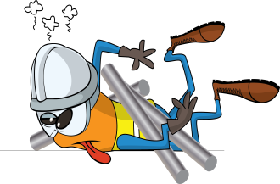
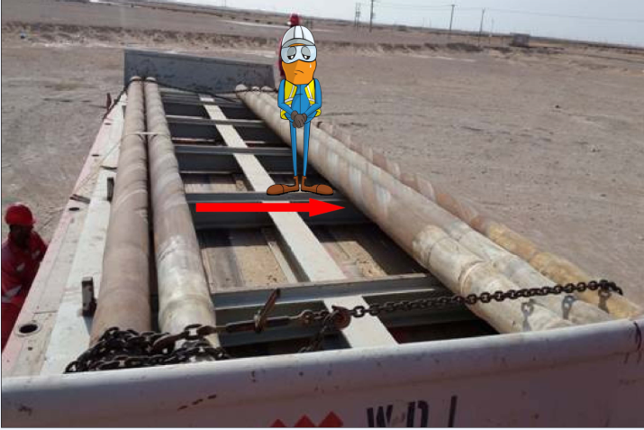
PDO Incident First Alert
Incident type | LTI (#18) | PIM ID | 1093999
Date/ time | 09/07/2016 (16:30 hrs) | Directorate
Location | Qarn Alam | Dept
What happened
A rig move helper was offloading drill collars from an open pipe skid which had been secured with chains and webbing straps during transportation. When tension in the strap was relaxed a collar rolled towards a helper standing on the skid and crushed his left foot against another collar fracturing his ankle badly.
Mr. Musleh asks the questions of can it happen to you?
Do you ensure pipes are stable before releasing restraints?
Do you always keep out of the “Line of Fire”?
Do you coordinate activities with your work colleagues?
Please disseminate this LTI notification to your teams and use it in your tool box talks and HSE meetings and notice boards.

