Slide 1
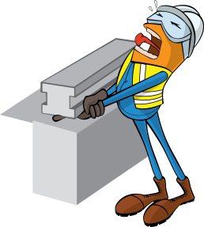
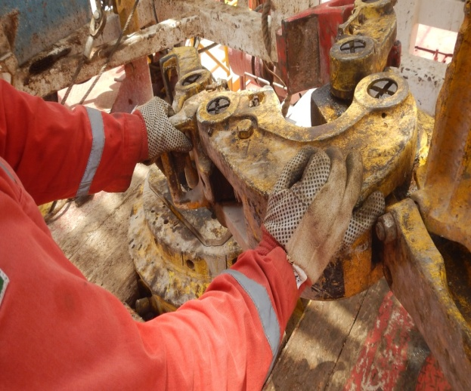
PDO Incident First Alert
Incident type | LTI (#20) | PIM ID | 1094124
Date/ time | 22/07/2016 (16:30 hrs) | Directorate
Location | Mawrid WSW-2/Marmul | Dept
What happened
Whilst preparing a drill pipe connection, the derrickman and a colleague lifted the tongs from the rig floor. Because he did not place his right hand on the handle and instead placed them on the tongs jaws, as they opened the jaws to fit around the 5” drill pipe his right little finger was crushed between the back of the jaw and its support arm, amputating his finger tip.
Mr. Musleh asks the questions of can it happen to you?
Do you ensure you keep your hands away of crush points?
Do you use the handles provided at all times?
Do you ensure you are wearing the correct gloves for the task?
Do you consider if you are ever in the ‘line of fire’?
Crush point
Please disseminate this LTI notification to your teams and use it in your tool box talks and HSE meetings and notice boards.

